Slide 1

Candidate Pack - Official Veterinarian
March 2024
Food Standards Scotland: Candidate Pack
Notes:
Job description for the role of Official Veterinarian
A map of Scotland showing the locations of the target premises for location of the OV posts – please come prepared to discuss your preferred location options
Details of the operations structure within FSS and how the structure links to the support and service to our staff and teams in the field
Information on the key benefits and reward systems that FSS operate as part of Scottish Government terms and conditions

Slide 2
Who we are and what we do
FSS was established on 1 April 2015 as the new public sector food body for Scotland. To protect the health and wellbeing of consumers we have three objectives as set under the Food (Scotland) Act 2015:
To protect the public from risks to health which may arise in connection with the consumption of food
To improve the extent to which members of the public have diets which are conducive to good health
To protect the other interests of consumers in relation to food
We have a unique role in government, working independently of Ministers and industry, to provide advice which is impartial, and based on robust science and data.
Our remit covers all aspects of the food chain which can impact on public health – aiming to protect consumers from food safety risks and promote healthy eating.
Further details about FSS, and the work we do, can be found on www.foodstandards.gov.scot

Slide 3
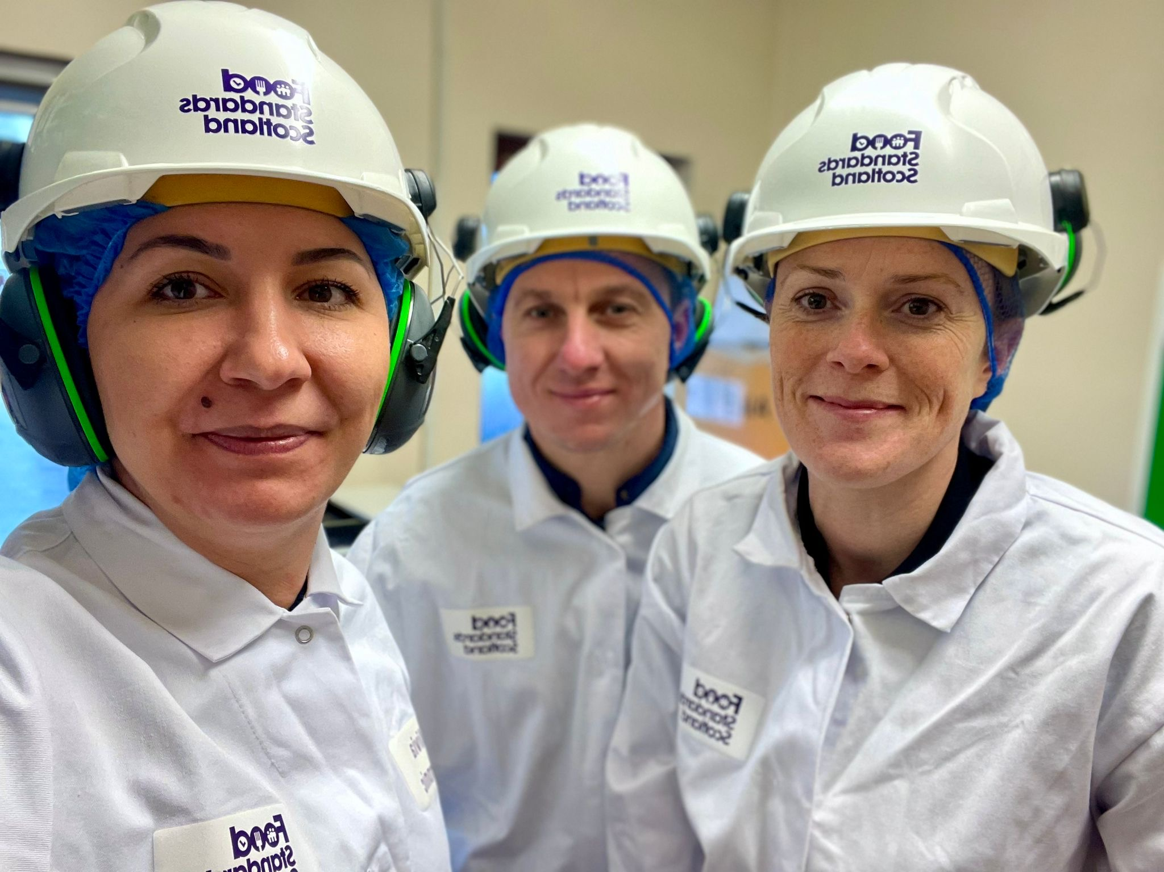
Official Veterinarian – Role and responsibilities
Overview:
The Official Veterinarian (OV) role is one of the key front-line operational roles within FSS. OVs deliver Official Controls (OC) in approved premises across Scotland, ensuring that meat produced is safe for human consumption.
The core work for the OV is the delivery of OCs related to products of animal origin (POAO) in FSS approved premises within Scotland (Red and White meat slaughterhouses, standalone Cutting Plants and Game handling establishments (GHEs)).
The FSS OV is the technical lead for field teams in all aspects related to verification of the Food Business Operator’s (FBO) compliance with all relevant legislation as stated in the FSS Scottish Manual for Official Controls (SMOC).

Slide 4
Official Veterinarian – Role and responsibilities Cont
Main activities and responsibilities of the role include:
Inspection tasks
Verification tasks
Actions following controls
Enforcement
Verification of compliance with Third country requirements (as/when needed)
Technical leadership of the plant inspection team
Stakeholder management
Health and Safety management
Delivery of FSS Service Level Agreements
For further details please click here:

Slide 5
Operations management team
The Operations management team is responsible for the delivery of the Official Controls that FSS carries out. We are committed to supporting our teams in the field and this is achieved through regular 1:1 conversations held with all staff members as part of routine visits to the plants.
We work across a diverse geographic area of Scotland and therefore we operate as three teams, each one comprising an Operations Manager (OM), two Field Operations Coordinators (FOC) and a Veterinary Advisor (VA).
As an OV you will join the other OVs in the area with the OM as your line manager. The VA will provide all technical help and advice as you grow and develop in the OV role.
We are all supportive of each other's roles and readily share our knowledge and experience to assist when needed.
Notes:
Details of the operations structure within FSS and how the structure links to the support and service to our staff and teams in the field

Slide 6
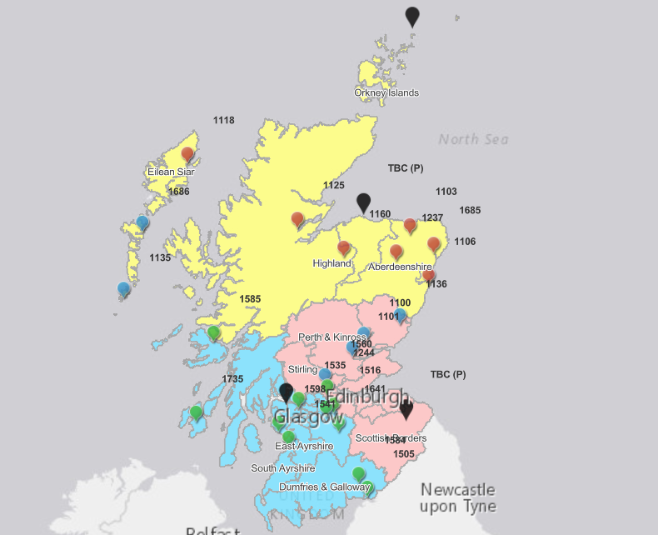
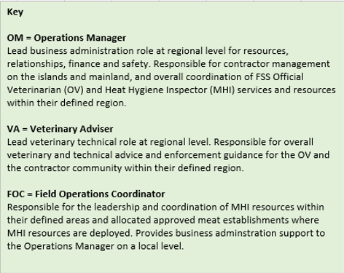
Operations Area Map

Slide 7
Operations management structure
Head of Operational Delivery
Head of Field Operations
Head Veterinarian
Area 1 Ops Manager
Area 2 Ops Manager
Area 3
Ops Manager
Area 1
Vet Auditor
Vet Advisor
Area 2
Vet Auditor
Vet Advisor
Area 3
Vet Auditor
Vet Advisor
FOC
FOC
FOC
FOC
FOC
FOC
Official Veterinarians (OVs) are line managed by the Operations Managers and receive technical guidance from the Vet Advisors
Meat Hygiene Inspectors

Slide 8
Career and benefits
Competitive starting salary of £39,767 (from 1st April 2026) and progression within the grade until you reach the maximum (currently £45,472).
Additional pay supplement of £4,250 per annum (upon successful completion of the OV training course)
Attractive pension with automatic enrolment into the Civil Service Pension Scheme with employee contributions starting at 4.6% and employer contributions from 26.6% (pay supplement also pensionable)
Generous leave allowance of 5 weeks per annum, increasing to 6 weeks after 2 years of service. Plus 11.5 public and privilege days per annum (12.5 in 2026/27).
Continuous professional development opportunities, including fully paid training of at least 35 hours per year. Membership of the Royal College of Veterinary Surgeons (RCVS) and the British Veterinary Association (BVA) – BVA Good Workplaces Silver Accreditation.
Read more details on the above benefits on our website
Notes:
Information on the key benefits and reward systems that FSS operate as part of Scottish Government terms and conditions

