Slide 1
Exporting to the EU - Fish
08 Jan 2021
Food Standards Scotland Operations

Slide 2
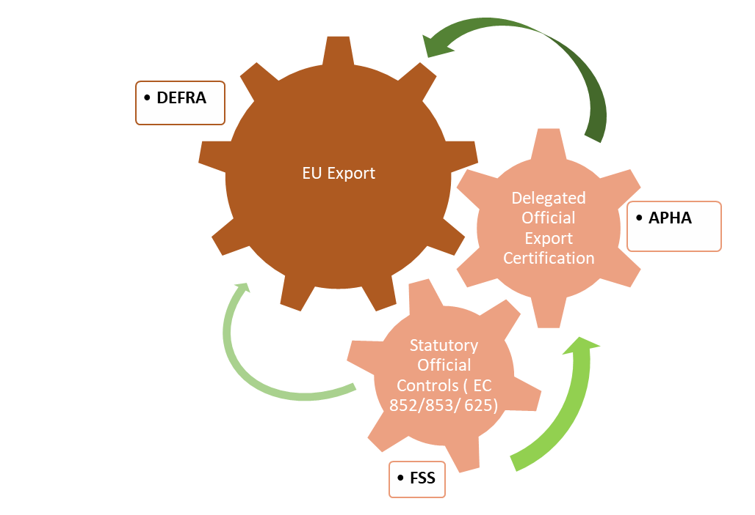
Export Official Certification
EU export requirements include compliance with Approved Premises applicable law
This includes Retained EU law ( EU 852,853, 625 and national surveillance programmes e.g. residues, biotoxins
Attestations are needed for Export OVs to sign EHCs are compliant with these.
Export OV is designated by APHA
APHA act on behalf of Scottish Ministers
EHC guidance issued by Defra based on negotiation and interpretation of EU commission requirements

Slide 3
Definitions
EXPORT HEALTH CERTIFICATE (EHC)
Official document issued by APHA and signed and stamped by an APHA trained OV confirming that an export meets the health requirements of the destination country.
There are 1900 EHCs (including ABPs) available at https://www.gov.uk/guidance/get-an-export-health-certificate
SUPPORT HEALTH ATTESTATION (SHA)
Document signed by an OV, Certification Support Officer or a registered Veterinary surgeon to confirm that the POAO accompanying the document has been produced in accordance with the requirements of the importing country.
In FSS approved establishments this is an FSS document.

Slide 4
Export Hub Model
As of 1 January 2021 FSS provide EHC services in 3 logistics hubs in Scotland’s central belt:
DFDS - based in Larkhall – expected to consolidate 350 consignments of seafood per day into 20-40 loads, with each load requiring an EHC. Certifying service requiremed 7 days per week
Mesguen – based in Harthill – expected to consolidate 100 consignments of seafood per day into approx 10 loads or less, with each load requiring an EHC. Certifying service required 6 days per week
JDot – based in Bellshill – expected to consolidate approx 5 loads per day, with each requiring an EHC. Certifying service required 6 days per week
Success is predicated on the Hub operators acting as exporter on behalf of their suppliers, providing accurate EHCs and supporting evidence and normally 1 EHC per consolidated load

Slide 5
FSS Delivery – out with hubs
New Export Health Cert SOP
FBOs will require to give a minimum of 5 working day notice (in writing) to the FSS Operations Manager
All product information and country where the product is to be exported should be stipulated in the request, along with the attendance time requested
OM will then respond within 4 hours
if FSS are unable to provide the service, the FBO will have to explore another arrangement
Alternative Business Agreement
A business agreement could be negotiated separately between the FBO and the Operations Manager but only if there is capacity to do so.
This would be advantageous to FBOs as it would eliminate the requirement of the 5 day notice period and also provide certainty.
If the FBO enters into a separate business agreement for EHCs they will be charged full cost whether they use the time or not

Slide 6
Fish Hub process
Staff hours are requested by the hub and have continued to be refined during the pilot phase
Mesguen and JDOt has 1 Certifying Officer (CO) per day
DFDS has 4 staff CO’s per day on 2 overlapping shifts from 0900-2100
The hub operator produces an EHC with all details completed for the CO to check
A Certifying Support Officer (CSO) provides admin support and conducts reality checks
Best estimates are that an EHC will take between 45 minutes to 2 hours to complete depending on complexity and assuming all data is correct
Reality checks are discretionary and risk based, driven by historical non compliance, but likely to be 15-30% of a load
It may be necessary for some loads to require more than one EHC depending on product type

Slide 7
Challenges Theme 1:
Communication
EHCs being completed by the Certifying Officers (COs), but some hubs later advising they’re not required
FBO representatives bringing FSS trailer numbers / load numbers, others bringing EHC numbers, however they are not linked in any way, which leads to getting more people involved in trying to reconcile them
Hub office staff are not adequately communicating with hub loading / chill staff
2 FBO staff have the ability to request and complete EHCs online, however neither one has access to the entire list for the hub, so they cannot see each other’s entries
There is no common terminology to identify a specific load leading to delays in reconciliation
Agreement required regarding the saving and sharing of final EHC certification

Slide 8
Challenges Theme 2:
FSS Administration & IT
Delays with equipment being sent to the wrong address and further delays due to the festive period
CSO still awaiting scanning software to be installed on their laptop
Various issues with access to printers, including connectivity
Various issues with connectivity to the internet

Slide 9
Challenges Theme 3:
SOP not being followed
Daily schedule of loads not being provided in advance, expectation that our CO’s will review the online platform regularly running the risk of EHC being missed
Paperwork not being provided, nor lists of batch numbers
Lack of communication between staff working in the chill and office staff
EHC being returned by the FBO for amendment following changes to product, weights etc resulting in new EHC having to be issued
Chiller / loading area staff unable to identify batch numbers, or the difference between batch and harvest codes
Last minute changes, even minor ones, lead to the EHC having to be amended, which takes time
Schedules (with batch numbers) should be clearly linked to the EHC, by the FBO, before being uploaded, at the moment this is being done by the CO

Slide 10
Challenges Theme 4:
FSS (and APHA) Technical & Operational matters
SOP requires validated and a series of minor amendments / clarifications to the SOP will be recommended separately
Various issues with the EHC platform related to numbering and references resulting in the CO having to do manual
entries (which takes time)
Utilising the ability to provide evidence to the CO by way of photos, CCTV, etc could be used more often
Improved communication and co-working is required to avoid duplication of work

Slide 11
Key Message 1:
Defra are the central competent authority, and issue the key notes for guidance

Slide 12
Key Message 2:
The Export Health Certificate journey involves significant preparation and input by the business.

Slide 13
Key Message 3:
FSS are assisting fish exporters with the EHC provision, even though this is not their statutory role.

Slide 14
Key Message 4:
There is no one-size fits all approach to the EHC signing process.

Slide 15
Key Message 5:
The exporter needs to ensure that all the documents and staff are aligned with the process for it to go smoothly

